Slide 1


Offline and Online UAV-Enabled Data Collection
in Time-Constrained IoT Networks
By
Oussama Ghdiri
Under the supervision of
Dr. Jihene Ben Abderrazak
Dr. Wael Jaafar
Graduation Project
April 7, 2021
Notes:
The obligation to reduce human contact as a health precaution has boosted the use of unmanned aerial vehicles It was really helpful for the human kind to overcome the pandemic. For instance

Slide 2
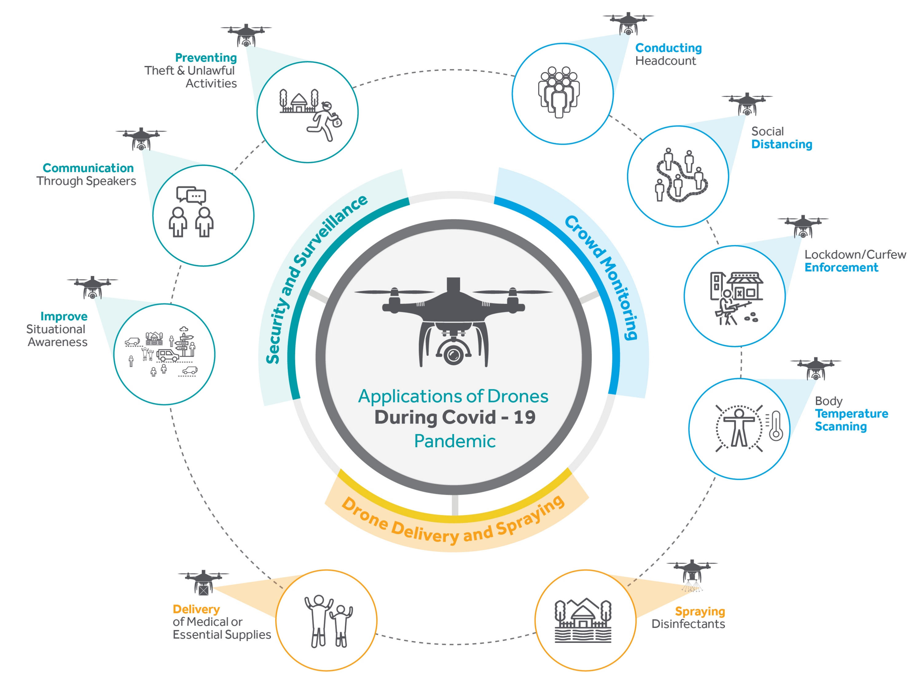
Source: Cyient
Notes:
The obligation to reduce human contact as a health precaution has boosted the use of unmanned aerial vehicles It was really helpful for the human kind to overcome the pandemic. For instance

Slide 3
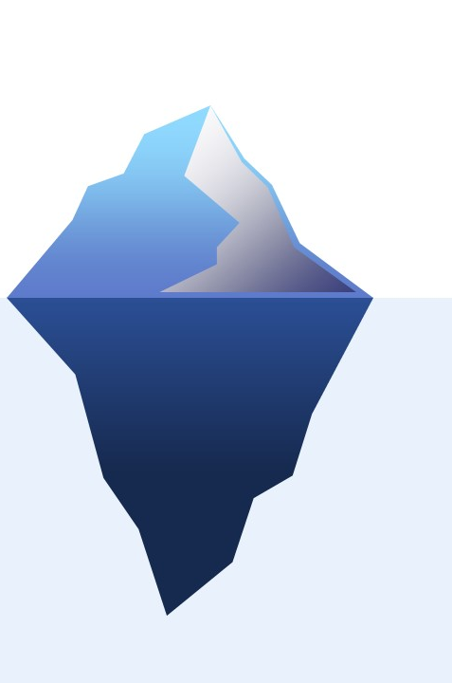
As a result, millions of people are profiting from UAVs
We are just at the tip of the iceberg
Notes:
Currently, the growth is in almost in every area creating new types of smart application and services

Slide 4

UAVs as Data collectors
Notes:
In order, to undercover what the future might bring, we propose in this project to use UAVs as data collectors.

Slide 5
Presentation Outline
1
Background & Motivation
2
Problem Formulation
3
Proposed Solution
4
Results and Discussion
5
Conclusions and Perspectives

Slide 6
1
Background & Motivation

Slide 7
1, Background & Motivation
The vision of Internet of Things has been constantly expanding in every aspect of life
127 Devices every second*
25 in 2021**
Billion
Generating an unprecedented amount of data
* Source: McKinsey
** Source: Statista
Notes:
Globally, an estimated of 127 new devices connect to the Internet every second. Moreover, experts estimate that the number of active IoT devices will surpass 25 billion devices by the end of 2021. enabling promising IoT applications, connecting millions of devices and people and generating an unprecedented amount of data that can be used to unlock new levels of intelligence.

Slide 8
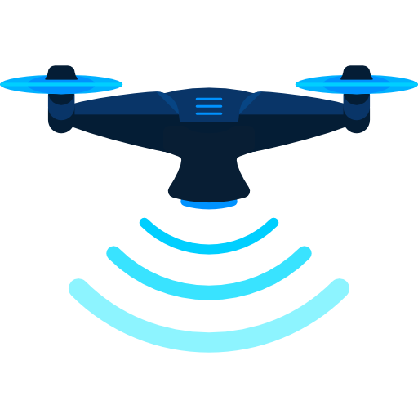
1, Background & Motivation
Given that IoT devices might be deployed in hard-to-reach areas and over moving targets, collecting data from these IoT nodes in a timely manner becomes very challenging
UAVs as flying data collectors has gained interest
Flexibility
Strong line-of-sight (LoS) communication channels
Reach low-power IoT devices
Notes:
Due to the UAVs’ high motion flexibility, strong line-of-sight (LoS) communication channels with ground devices, and moderately low flying altitudes to reach low-power IoT devices, UAV-based data collection is seen as the trigger of future and new applications

Slide 9
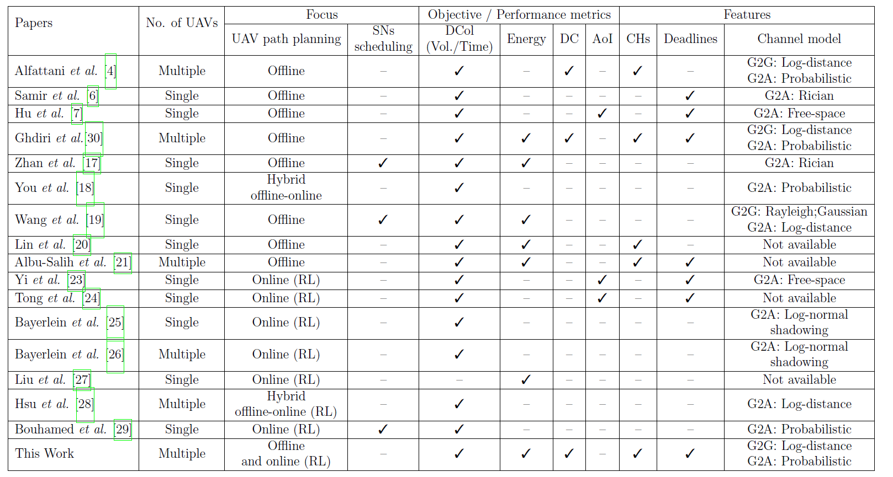
1, Background & Motivation
State of the art
Notes:
In our work we tried to overcome the weaknesses of the previous works and proposed a complete framework using Multi-UAV to collect data from IoT time constrained networks

Slide 10
2
Problem Formulation

Slide 11
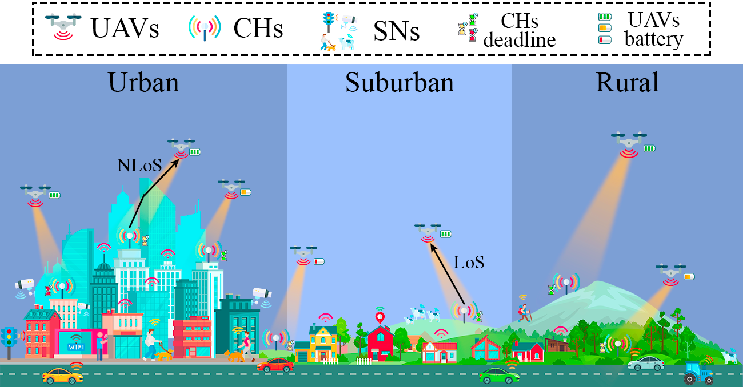
2, Problem Formulation
System Model
Notes:
To better understand the system model, we made this illustration . If you look at this figure you will see that we focus on collecting data from different heterogeneous sensors for example from autonomous cars, surveillance cameras, ,,,
whether in urban, suburban or rural env, we try to aggregate the data of those SNs into one super SN called CH and each CH has a specific deadline to before the data become outdated.

Slide 12
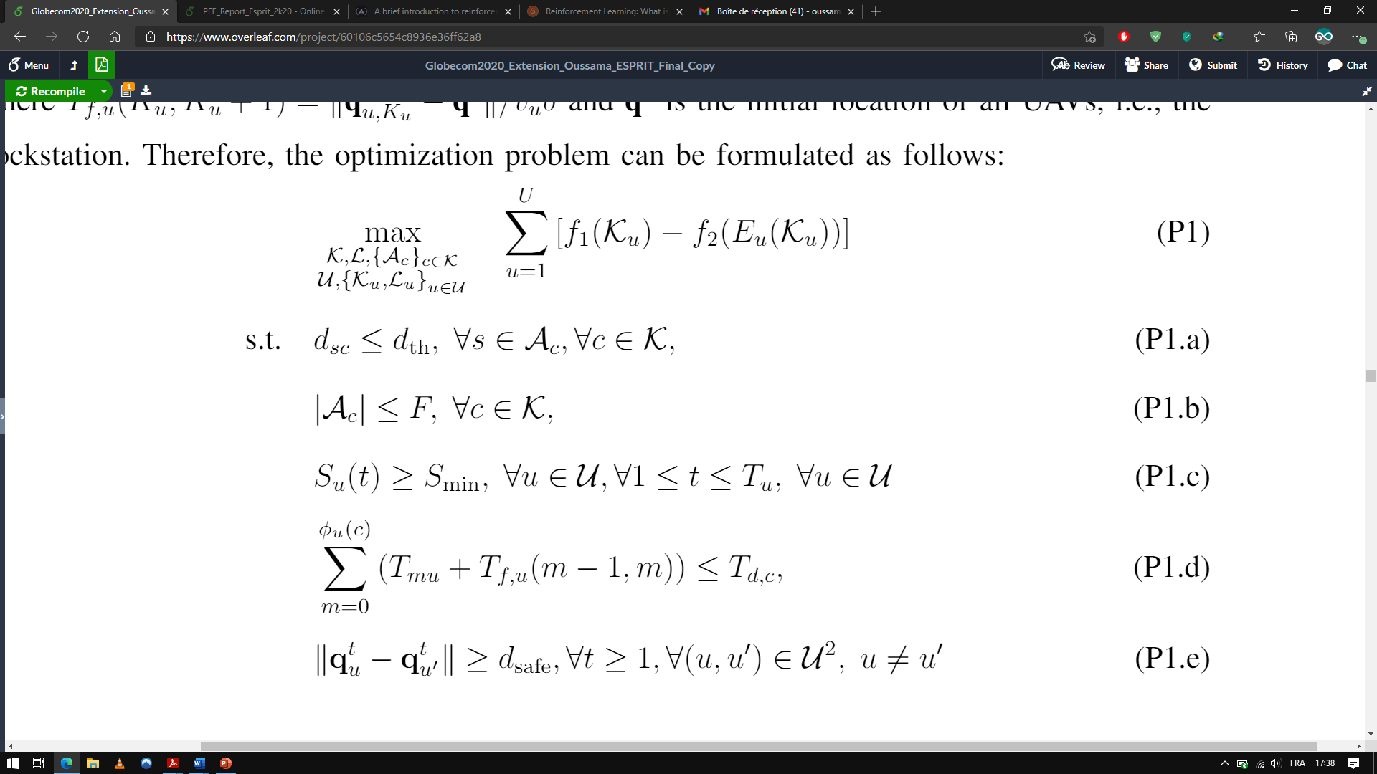
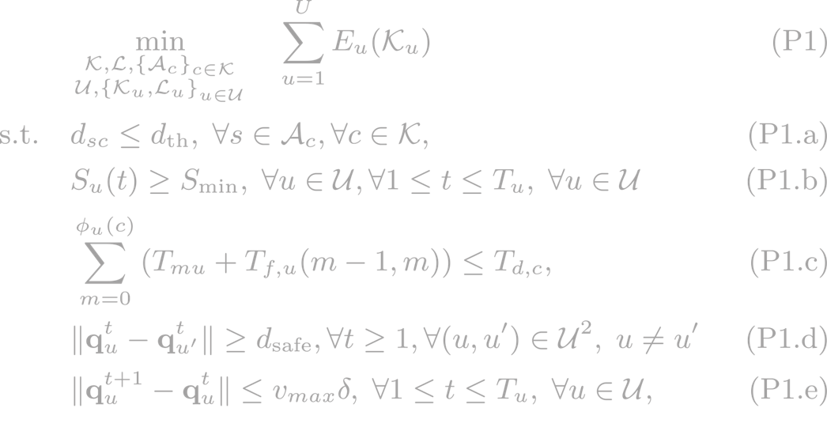
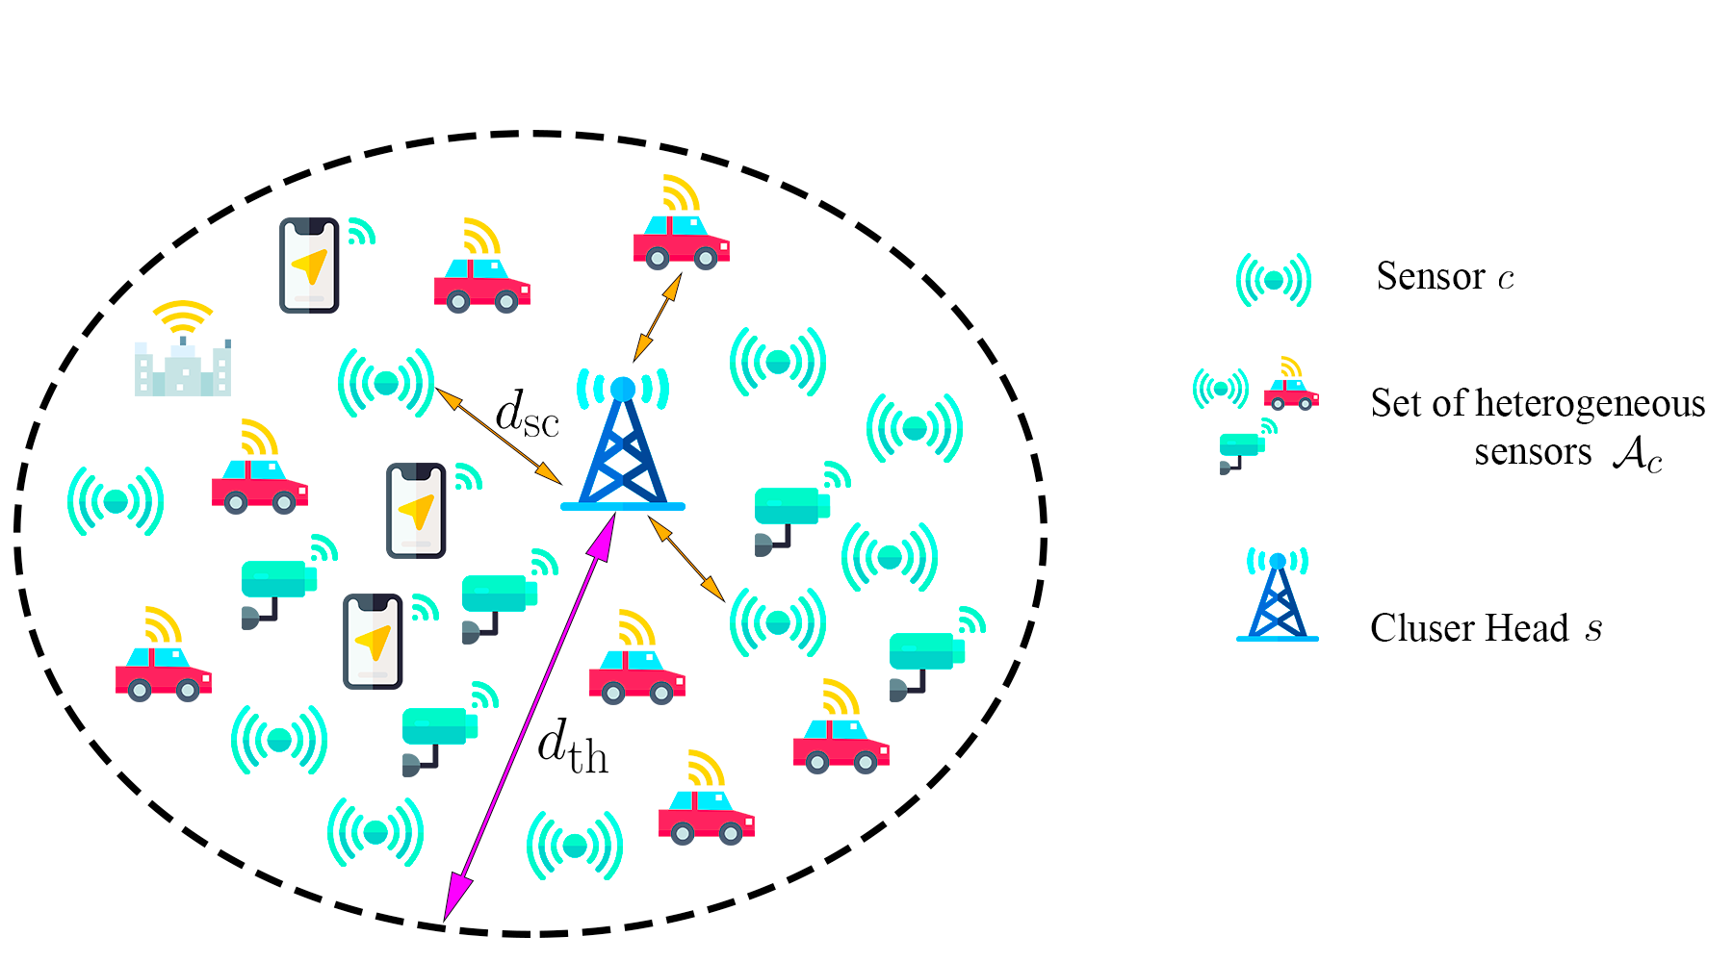
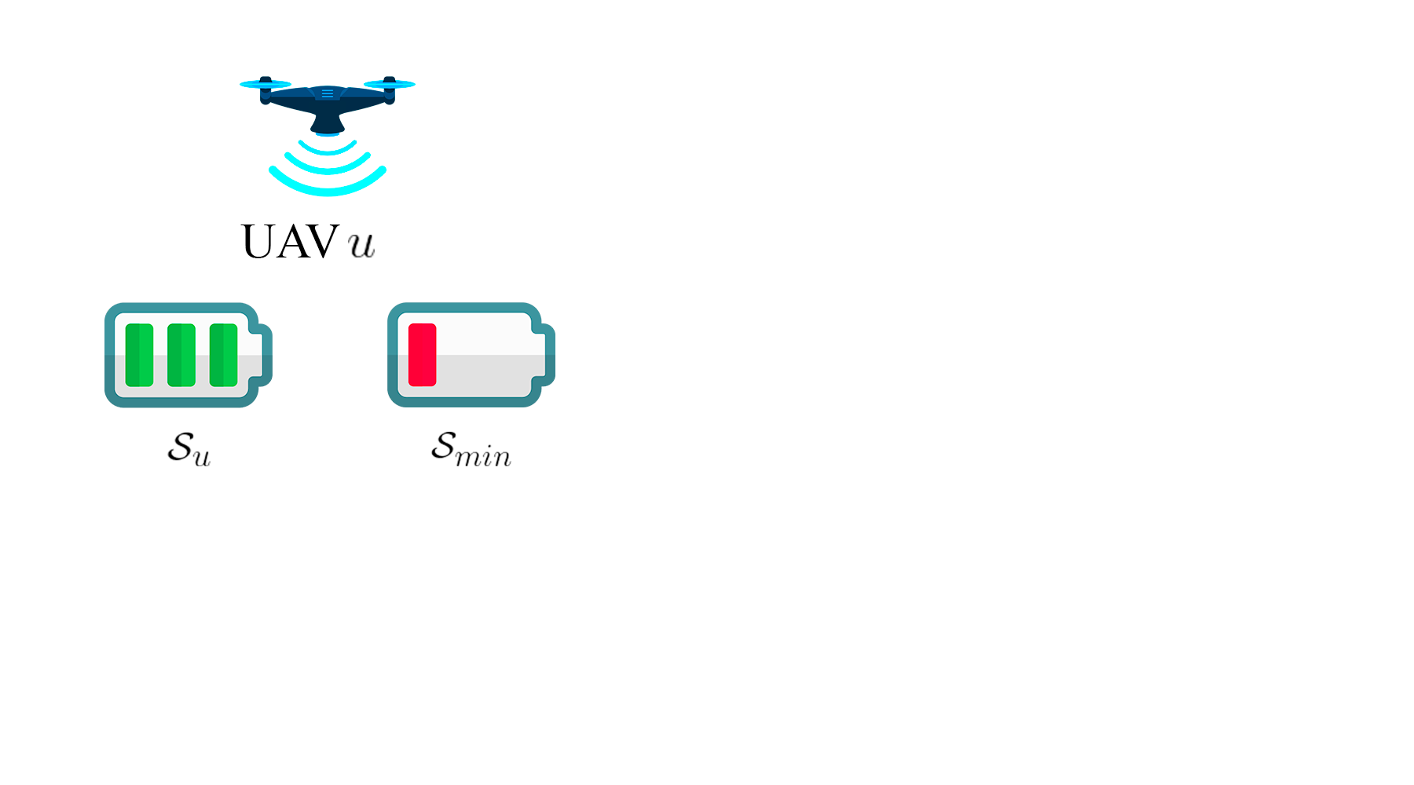
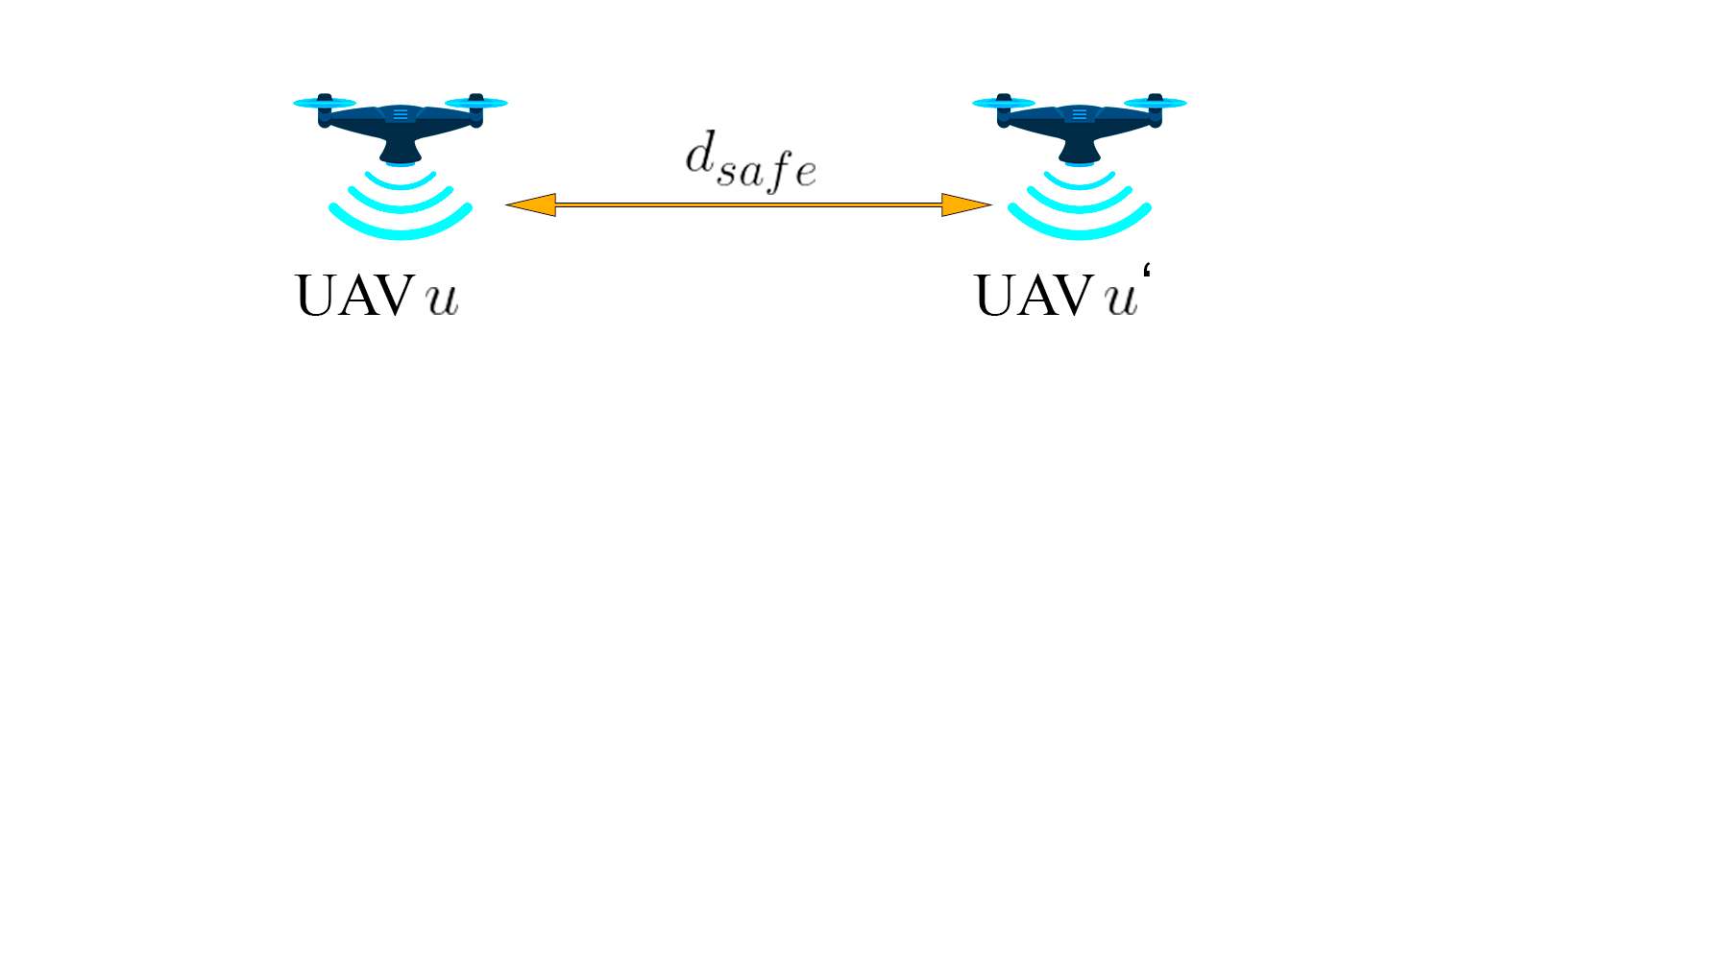
2, Problem Formulation
Problem Formulation
Maximize energy efficiency
Maximize data collection
Ensure a successful communication between SN and CH
Guarantee that enough energy is available
Satisfy that UAV collects data from CHs before deadlines
Ensure that no collisions occurs between UAVs
Notes:
The formulated optimization problem is determined by the following mathematical model.
The objective is to minimize the total energy consumption in the process of collecting data from CHs ensuring a successful communication between SN with their associated to CH using multiple UAVs that have enough on board battery capacity. So, the objective in to collect data from the maximum number of CHs before
information deadline. Which implies finding the most suitable trajectory guaranteeing that no collision occurs between UAVs.

Slide 13
3
Proposed Solution

Slide 14
3, Proposed Solution
Problem P1 is divided into two sub-problems
IoT sensors clustering
Efficient SNs clustering
Strategic CHs placement
2. Multi-UAV Trajectory Planning
Careful design of UAVs’ trajectories
The offline scenario corresponds to applications for dedicated or private IoT networks
The online scenario corresponds to applications where IoT sensors are mobile or their location information is fully or partially unavailable

Slide 15
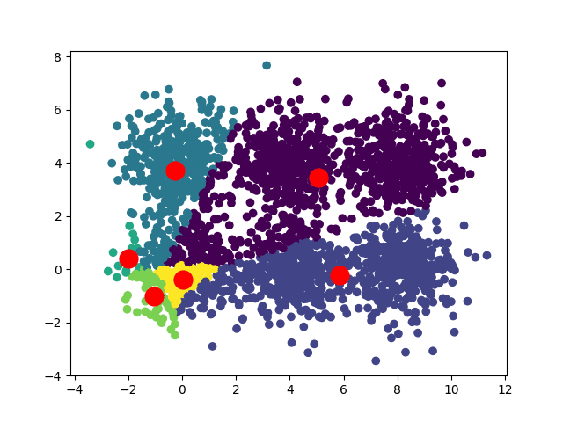
3, Proposed Solution
IoT sensors clustering (1/2)
Partitioning methods
Partition data into k subsets based on the characteristics and similarity of the data
Used algorithms
K-means
Proposed K-means based algorithm

Slide 16

3, Proposed Solution
IoT sensors clustering (2/2)
Hierarchical methods
Create a hierarchical decomposition of the data
Represented graphically by a Dendrogram
Used algorithms
Hierarchical Agglomerative
Clustering (HAC)

Slide 17
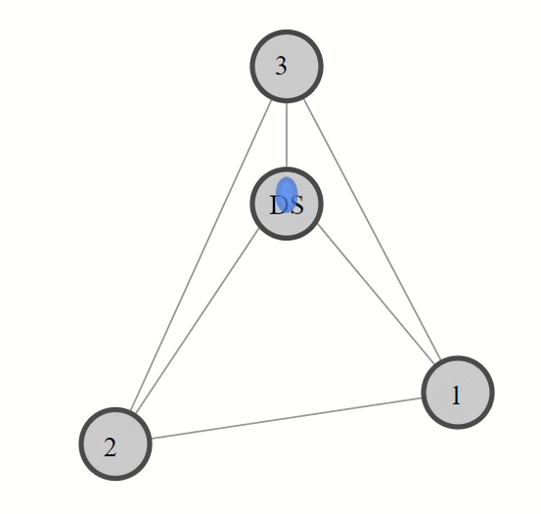
3, Proposed Solution
Multi-UAV Trajectory Planning (1/6)
Offline Path Planning: Meta-heuristic Approaches
Graph-Based Approach
Shortest path
Vehicle Routing Problem with Time Windows
Three metaheuristics algorithms :
Guided local search
Simulated annealing
Tabu search
Notes:
Given the best location of CHs, we focus now on finding the UAV's appropriate path planning that may significantly decrease the energy consumption.
So we convert this problem into a graph so that we can find the best routes and by the best we mean the shortest path respecting deadline constraint.
Our approach is inspired from one of the most important applications of optimization which is vehicle routing problem with time-windows (VRPTW) to minimize the total flying distance and the number of UAVs needed to complete the mission.

Slide 18
3, Proposed Solution
Multi-UAV Trajectory Planning (2/6)
Online Path Planning: Reinforcement-Learning based Approaches (1/5)
Reinforcement learning is about solving problems by trial and error
Agent is an assumed entity which performs actions in an environment to gain some reward.
The Environment is the world that contains the agent and allows the agent to observe that world's state.
A state is a complete information description of the world
An observation is what the agent sees about the current state
Notes:
So first just to get everybody on the same page the agent is

Slide 19
3, Proposed Solution
Multi-UAV Trajectory Planning (3/6)
Online Path Planning: Reinforcement-Learning based Approaches (2/5)
The Agent receives state s_{t} from the environment
Based on that state s_{t}, the agent takes an action a_{t}
The Environment gives some reward r_{t} to the agent
The environment becomes in a new state s_{t+1}
This loop continues to form an Episode, which is a sequence of interaction between agent and environment.
Agent
State s_{t}
Action a_{t}
Reward r_{t}
Environment

Slide 20
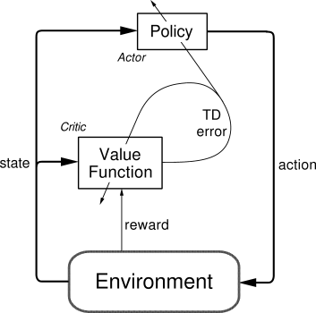
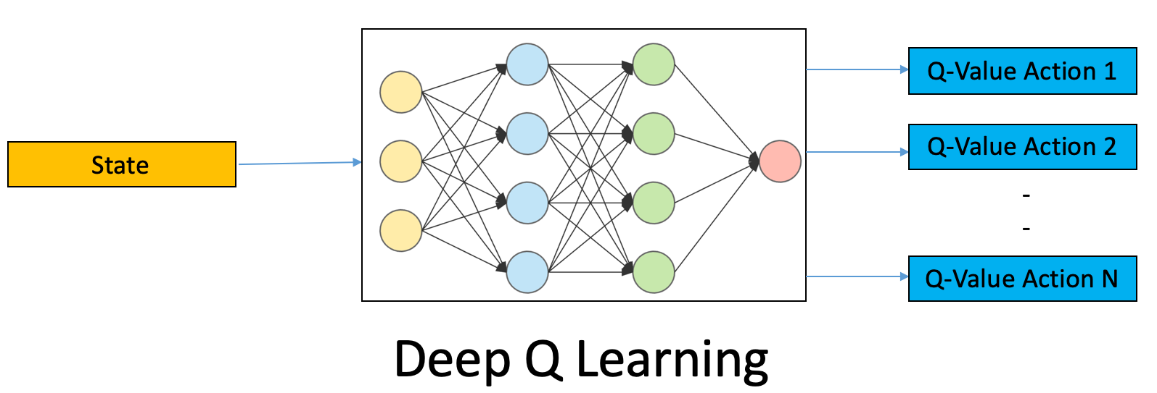
3, Proposed Solution
Multi-UAV Trajectory Planning (4/6)
Online Path Planning: Reinforcement-Learning based Approaches (3/5)
Value-based or Q-learning: Maximize a value function Q(s)
Used algorithms
DQN
DDQN
Policy-based: Optimize a policy π
Used algorithms
Actor-critic

Slide 21
3, Proposed Solution
Multi-UAV Trajectory Planning (5/6)
Online Path Planning: Reinforcement-Learning based Approaches (4/5)
Trained a multi-task agent for 1024 episodes
For each episode, we assume that the locations of SNs (and subsequently of CHs) are varying and unknown for the UAVs
UAVs explore the cells and reach the CHs to collect the maximum amount of data within the time and energy limitations

Slide 22
3, Proposed Solution
Multi-UAV Trajectory Planning (6/6)
Online Path Planning: Reinforcement-Learning based Approaches (5/5)
Exploration vs Exploitation
Exploration is all about finding more information about an environment
Exploration = less reward, but understand environment better
Exploitation is exploiting already known information to maximize the rewards
Exploration = more reward, may be missing out on a part of environment
Trade-off between exploration and exploitation

Slide 23
4
Results and Discussion

Slide 24
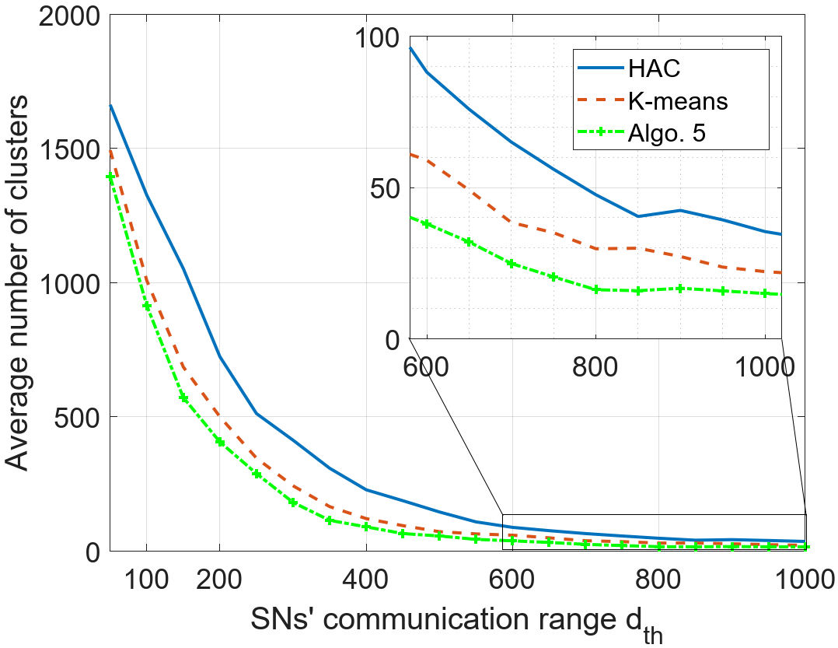
4, Results and Discussion
Clustering performance (1/3)
2000 SNs in 5x5 Km² area
Required number of CHs for different d_{th}
Small d_{th} → Higher number of CHs
Algo. 5 provides the best clustering performance

Slide 25
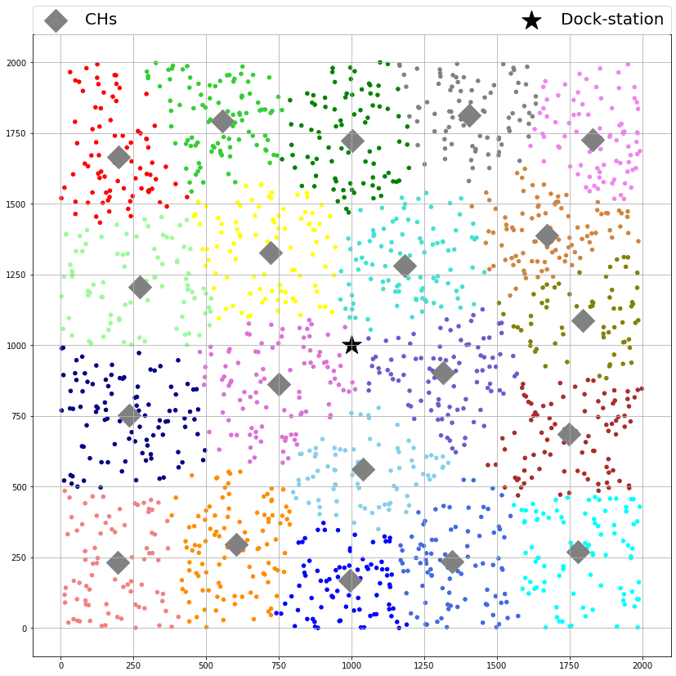
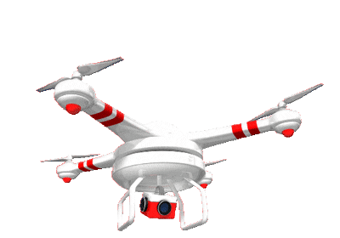

4, Results and Discussion
Clustering performance (2/3)
Above Vs Within a range from CHs
Notes:
Three combinations of IoT sensors clustering methods and UAVs’ hovering techniques

Slide 26
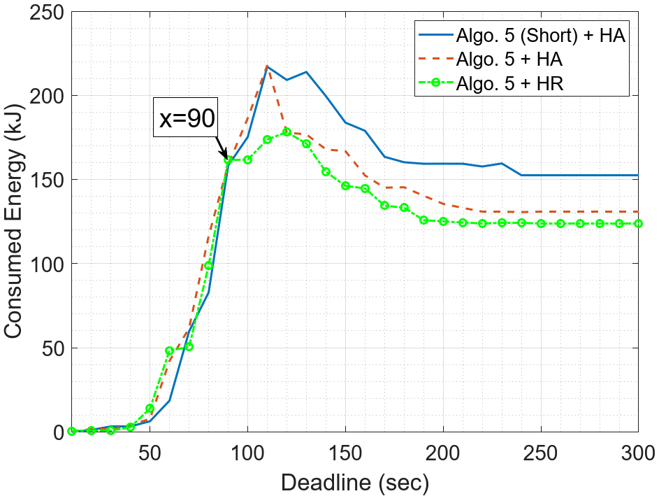
4, Results and Discussion
Clustering performance (3/3)
Three combinations of IoT sensors clustering methods and UAVs’ hovering techniques
12 UAVs with 3500 mAh battery capacity
Collecting data within a range presents the best energy consumption performance

Slide 27
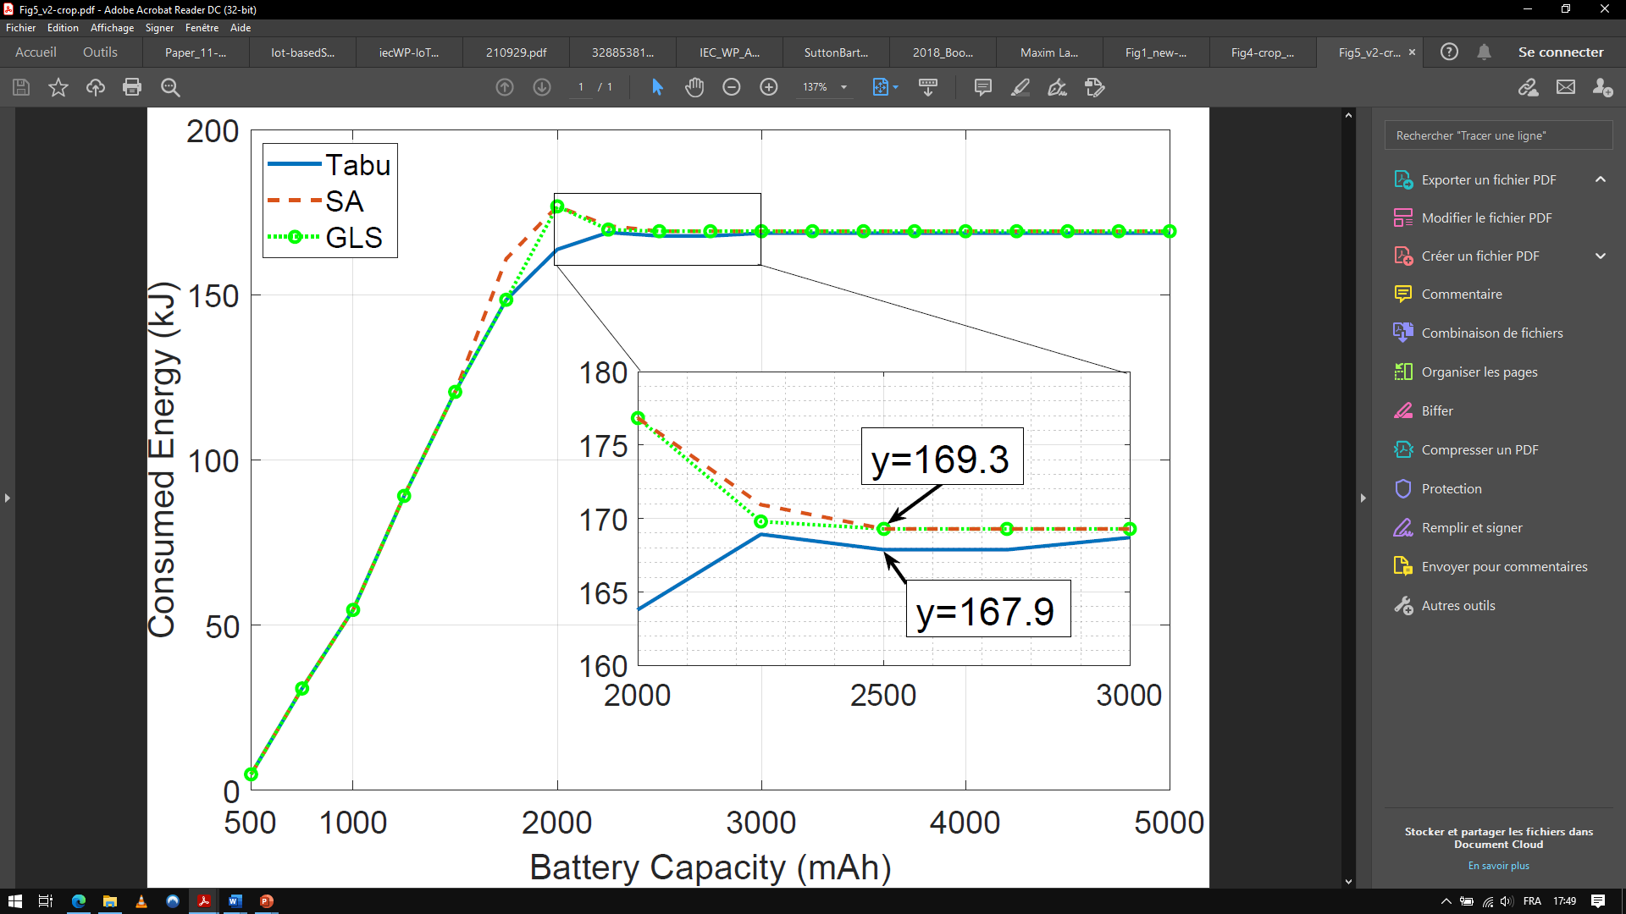
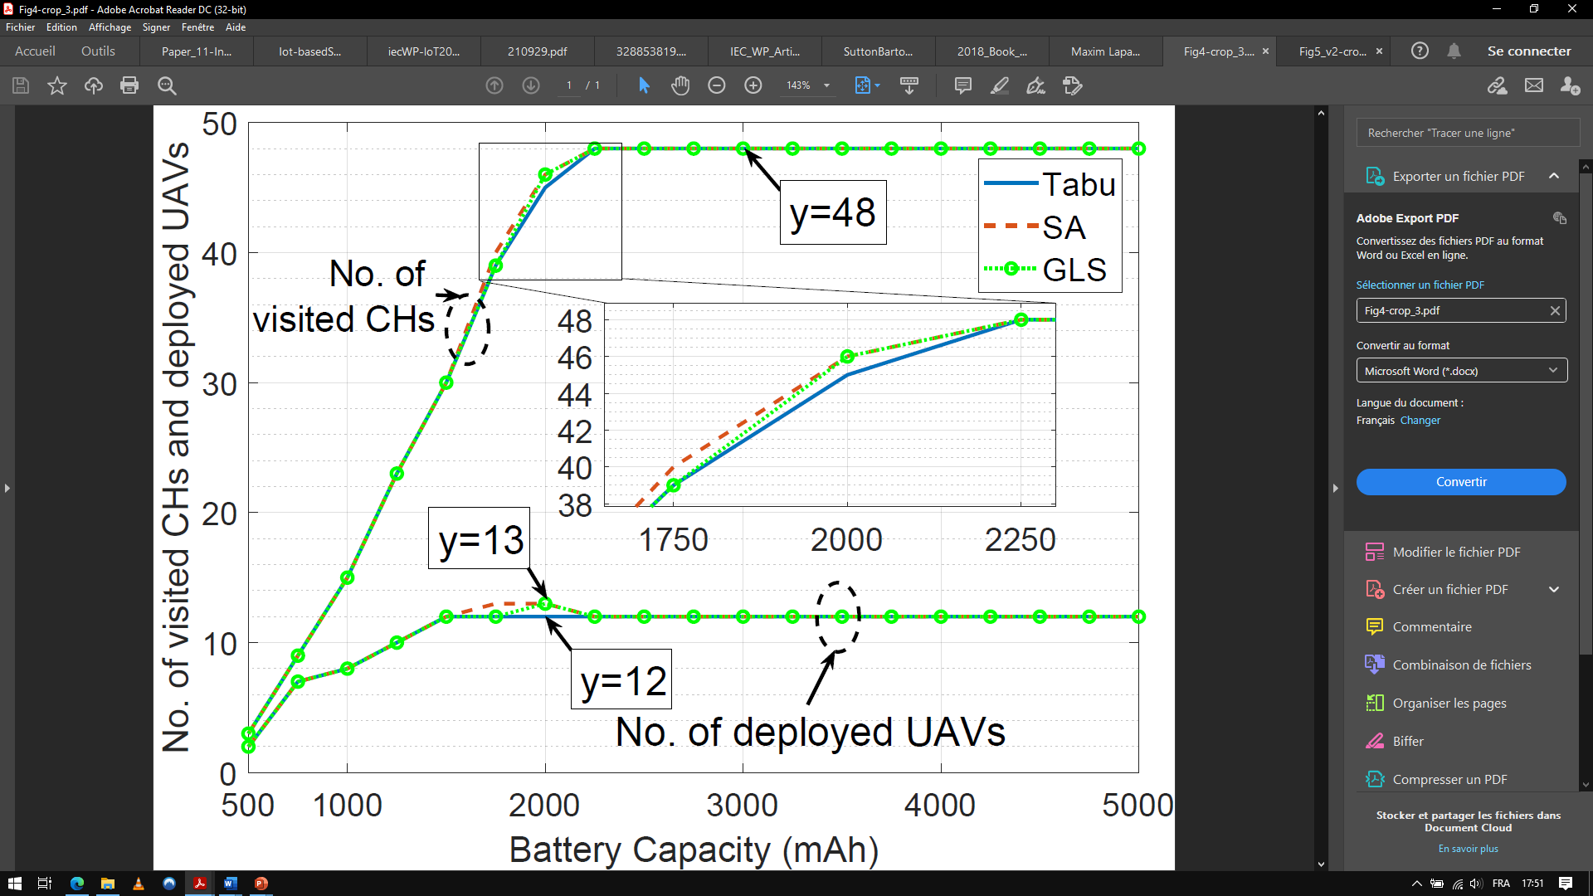
4, Results and Discussion
Offline path planning
Collecting data from 48 CHs with 140s deadline before data becomes outdated
Performances of these methods are almost similar, with a preference for Tabu
As the battery capacity increases the performance saturates, thus guaranteeing that data is collected from all CHs

Slide 28
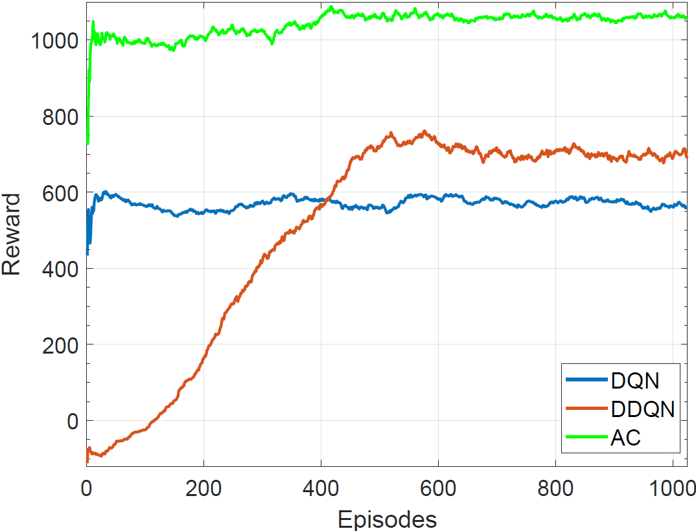
4, Results and Discussion
Online path planning (1/4)
3 UAVs with medium battery capacity
1800 SNs in 2000x2000 gridworld (2x2 Km²)
Collecting data from CHs with low deadlines
DQN and AC are faster to converge than DDQN
Actor-Critic achieves the best performance

Slide 29
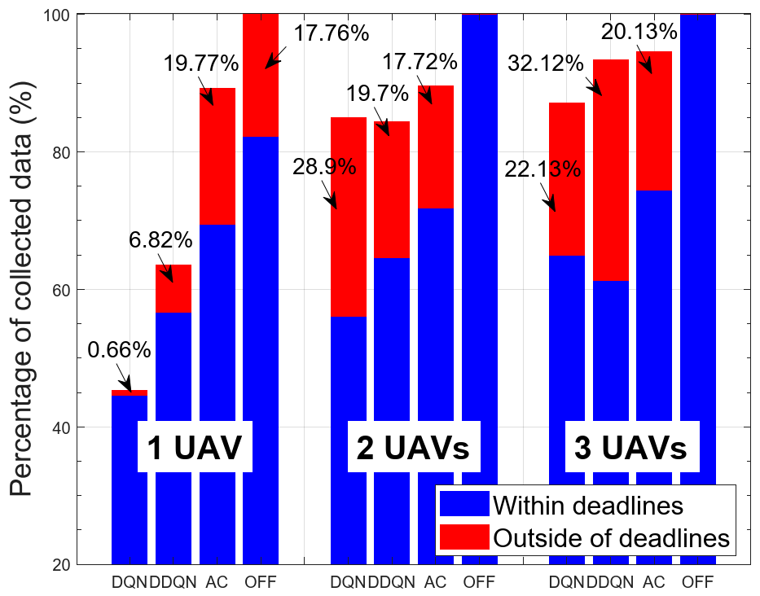
4, Results and Discussion
Online path planning (2/4)
Comparing the percentage of collected data between offline and online approaches
Tabu search performance is the benchmark
Using 3 UAVs we reached more than 95% of CHs

Slide 30
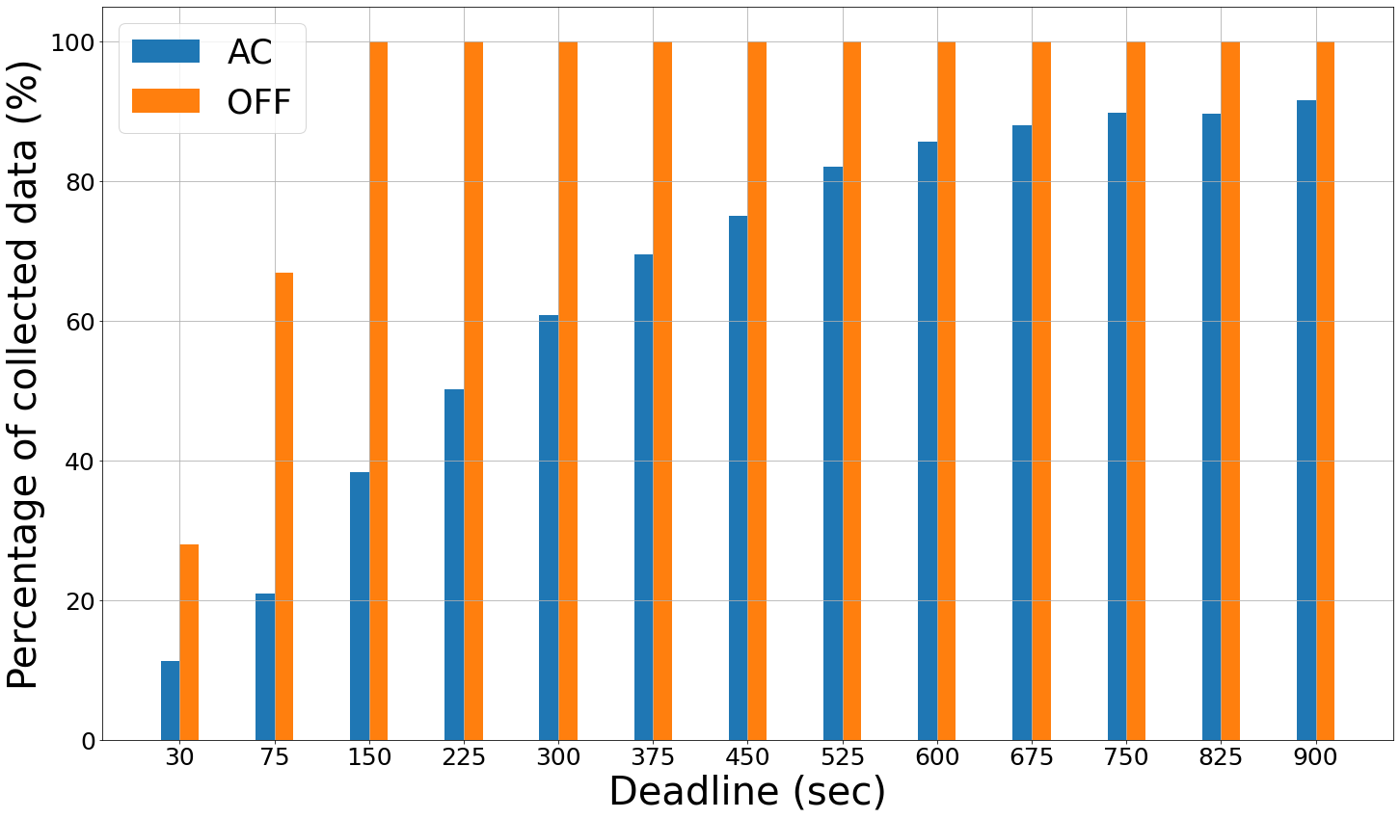
4, Results and Discussion
Online path planning (3/4)
As the deadline increases, both AC and OFF improve until reaching a saturation value
OFF saturates from deadline 150sec, for which 100% of the data is collected
AC reaches a maximum of 90% starting from deadline 750sec

Slide 31
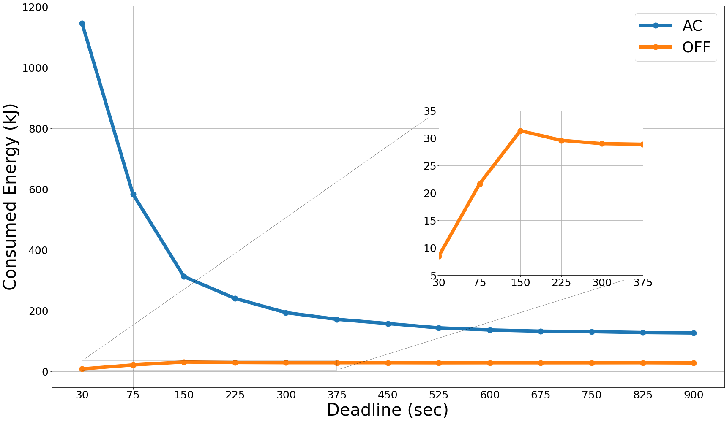
4, Results and Discussion
Online path planning (4/4)
OFF reaches a consumption peak then decreases, mainly due to better UAV paths
AC consumes a lot of energy for short deadlines since the UAVs waste a lot of energy exploring without any income
This large gap is due to the advantageous knowledge of the system status

Slide 32
4, Results and Discussion
List of Publications
O. Ghdiri, W. Jaafar, S. Alfattani, J. B. Abderrazak and H. Yanikomeroglu, ”Energy-Eﬃcient Multi-UAV Data Collection for IoT Networks with Time Deadlines,” Proc. GLOBECOM 2020 - 2020 IEEE Global Communications Conference, Taipei, Taiwan, 2020
O. Ghdiri, W. Jaafar, S. Alfattani, J. B. Abderrazak and H. Yanikomeroglu, ”Oﬄine and Online UAV-enabled Data Collection in Time constrained IoT Networks,” in IEEE Transactions on Green Communications and Networking - Special Issue - Selected papers from IEEE Globecom’20 (submitted)

Slide 33
5
Conclusions and Perspectives

Slide 34
5, Conclusions and Perspectives
Conclusions (1/2)
Multi-UAV data collection problem in clustered IoT networks, where sensed data have time deadlines, was investigated
Deployment energy costs were minimized through a two-step optimization approach:
1) IoT sensors clustering and CHs optimal placement
2) UAVs deployment and trajectories planning

Slide 35
5, Conclusions and Perspectives
Conclusions (2/2)
Our customized K-means clustering method outperformed baseline approaches in terms of number of CHs
Tabu search provided the best UAVs deployment strategies for energy minimization
Actor-Critic outperforms DQN and DDQN in terms of amount of collected data and energy consumption
Actor-Critic is capable of collecting up to 90% of the data without any prior knowledge of the IoT network

Slide 36
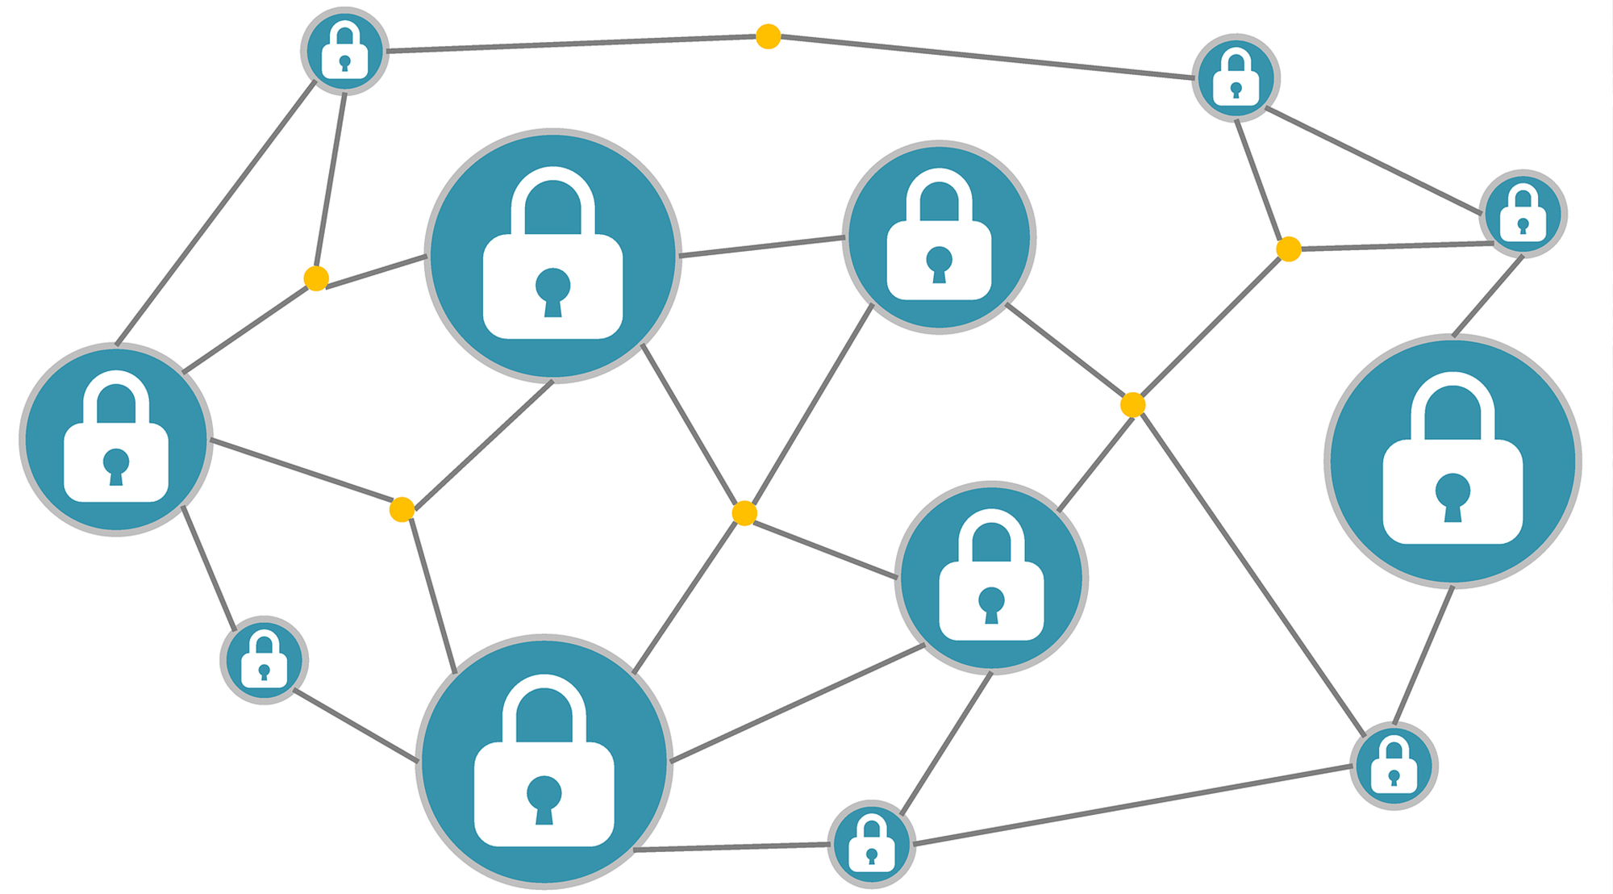


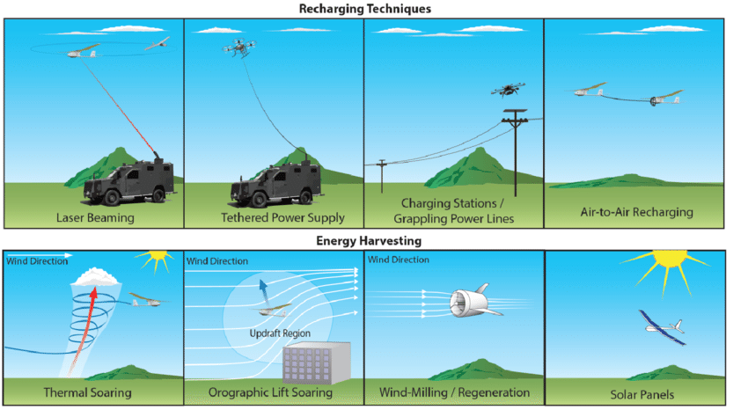

5, Conclusions and Perspectives
Perspectives
In our future works, we plan to:
Use energy harvesting
Deploy mobile SNs
Secure all data transactions

Slide 37
THANK YOU
ANY QUESTIONS?

